Slide 1
AME20216 - Lab I L6 – AC Electronics

Slide 2
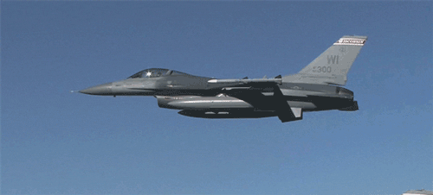
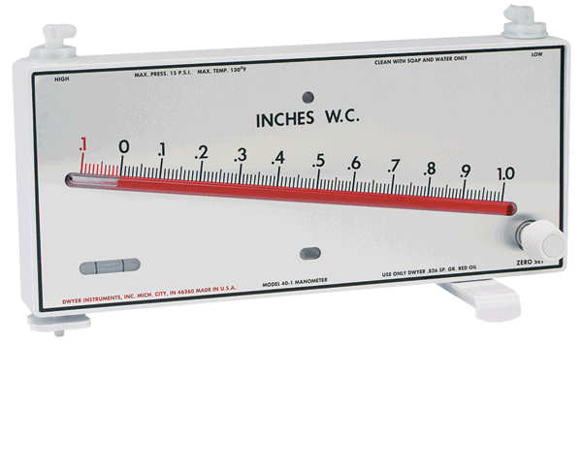
Multi-point Calibration

Slide 3
Parallel Plate Capacitor
Capacitors store electrical charge and energy.
Electrical Capacitiance
“Dielectric” material sandwiched between 2 metal plates.

Slide 4
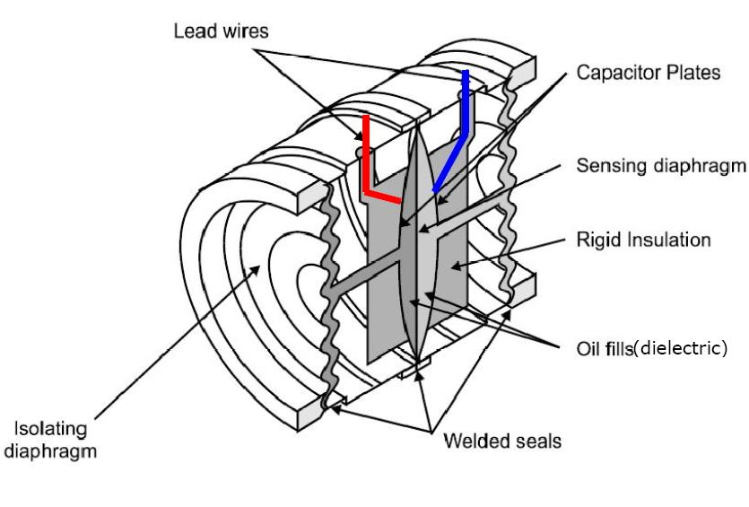
A4 - Capacitive Pressure Transducer
Pressure pushes capacitor plates closer together
Capacitive presssure sensor
C_{OUT}
Capacitance-to-voltage IC chip
V_{OUT}

Slide 5
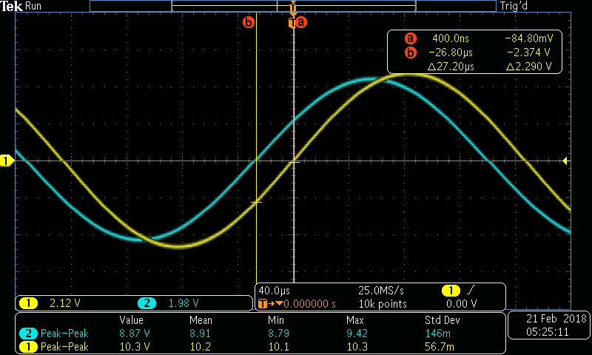
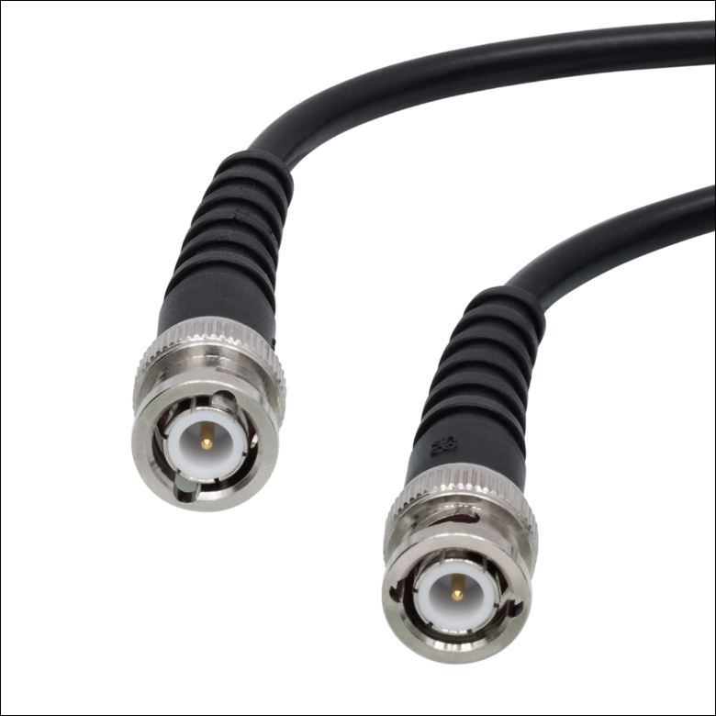
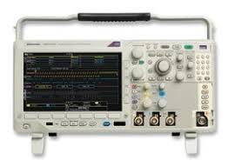
A5 – Electronics II
Oscilloscope
Coaxial Cable

Slide 6
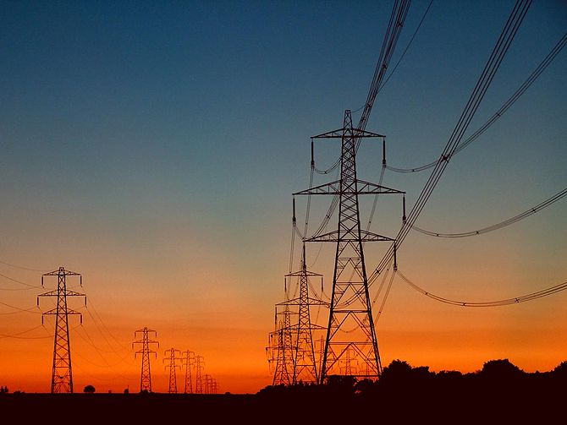
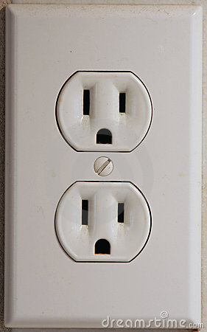
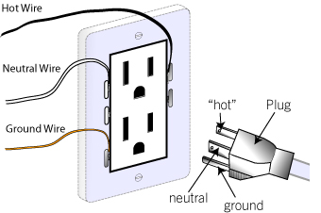
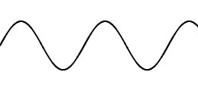
Alternating Current (AC)
60 Hz, 120 V_{RMS}

Slide 7
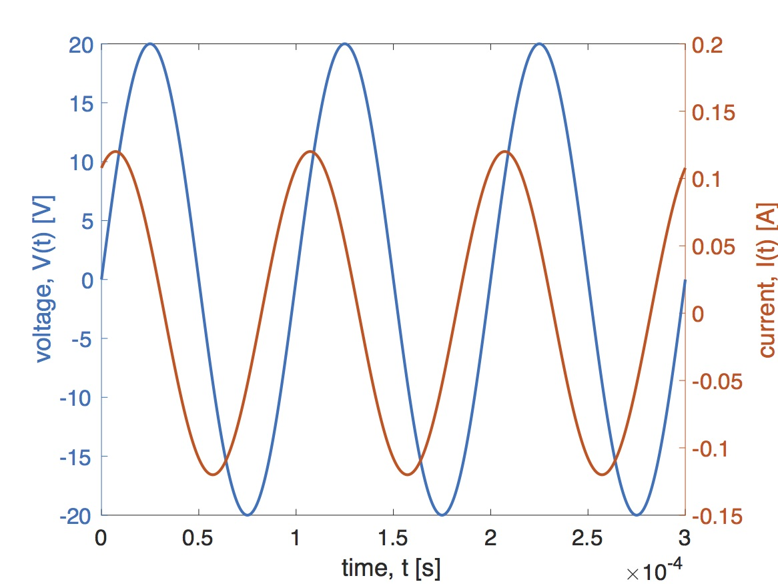
Alternating Current

Slide 8
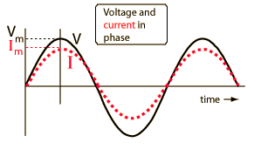
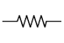
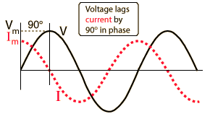
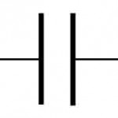
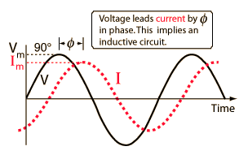
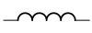
Phase
Resistor
R
Capacitor
C
Inductor
L
http://hyperphysics.phy-astr.gsu.edu

Slide 9
A5 – Electronics II
Amplitude
Phase

Slide 10
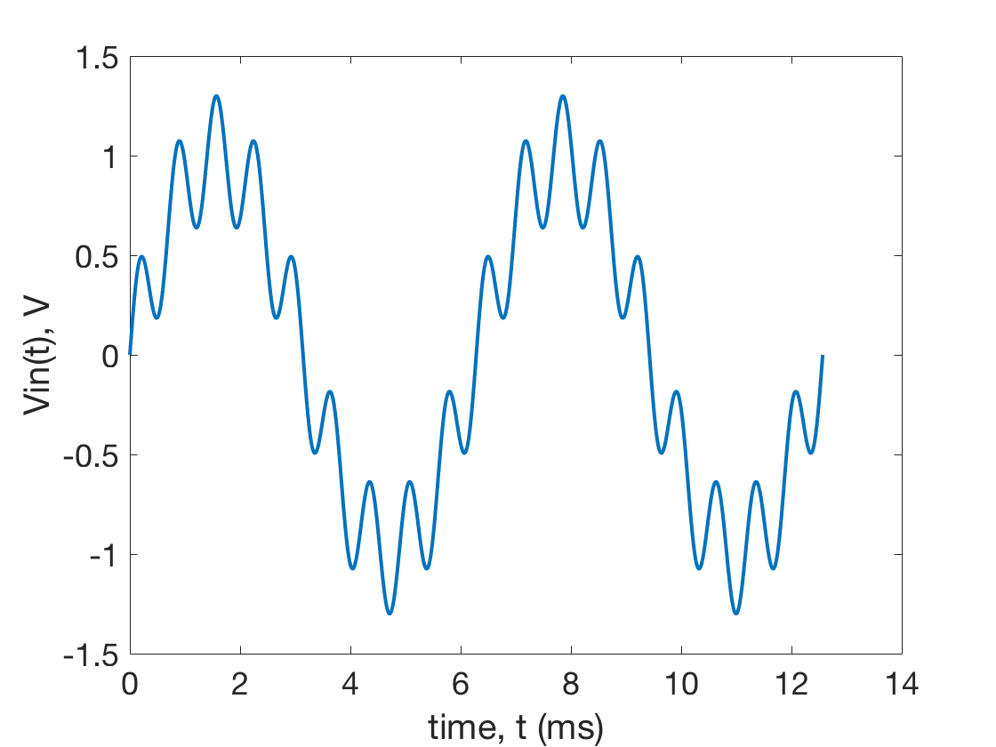
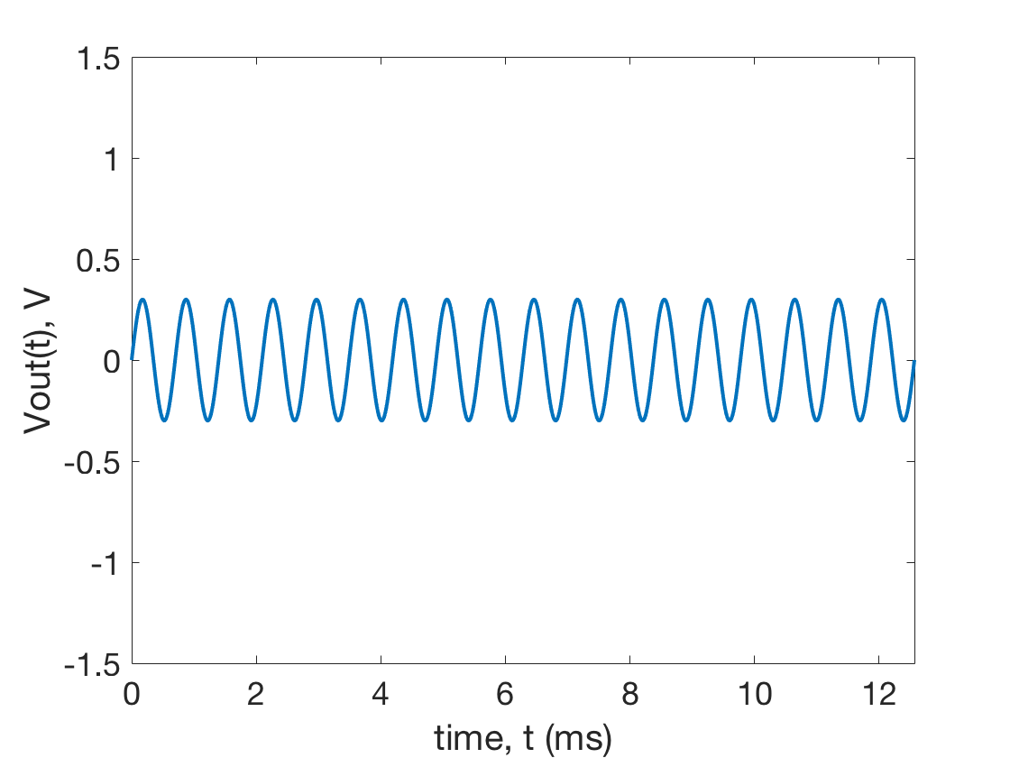
High-Pass Filter

Slide 11
Memorize it:

Slide 12
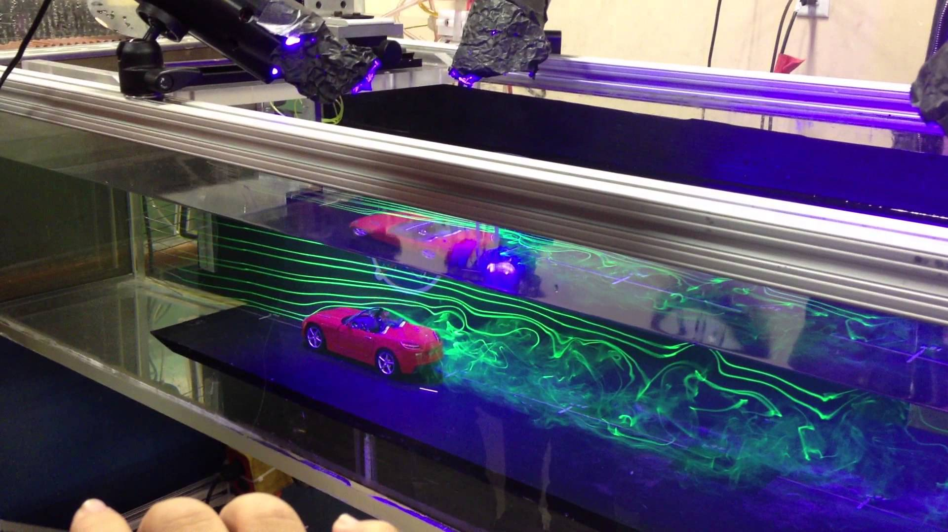
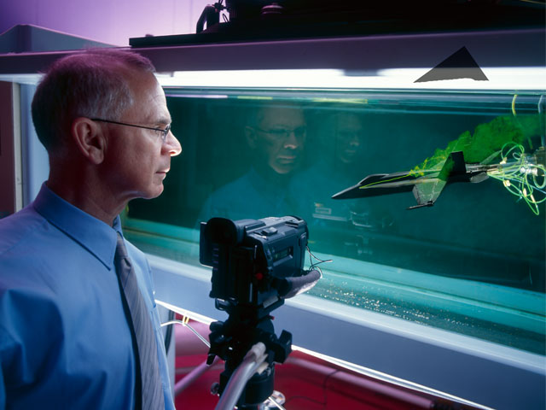
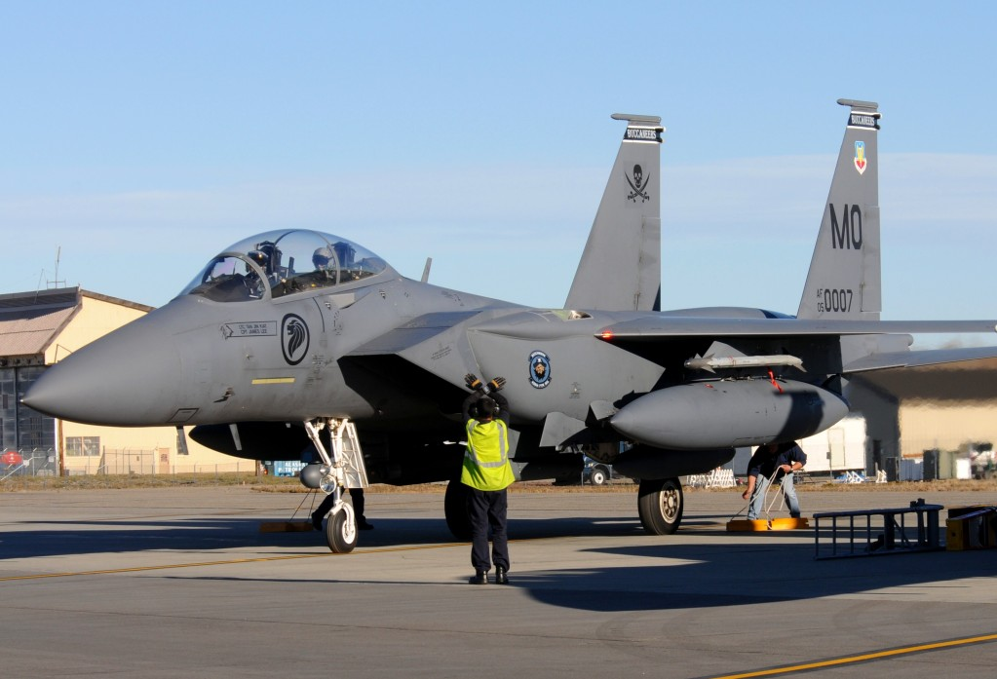
Non-dimensional Parameters
Reynolds Number

